Slide 1
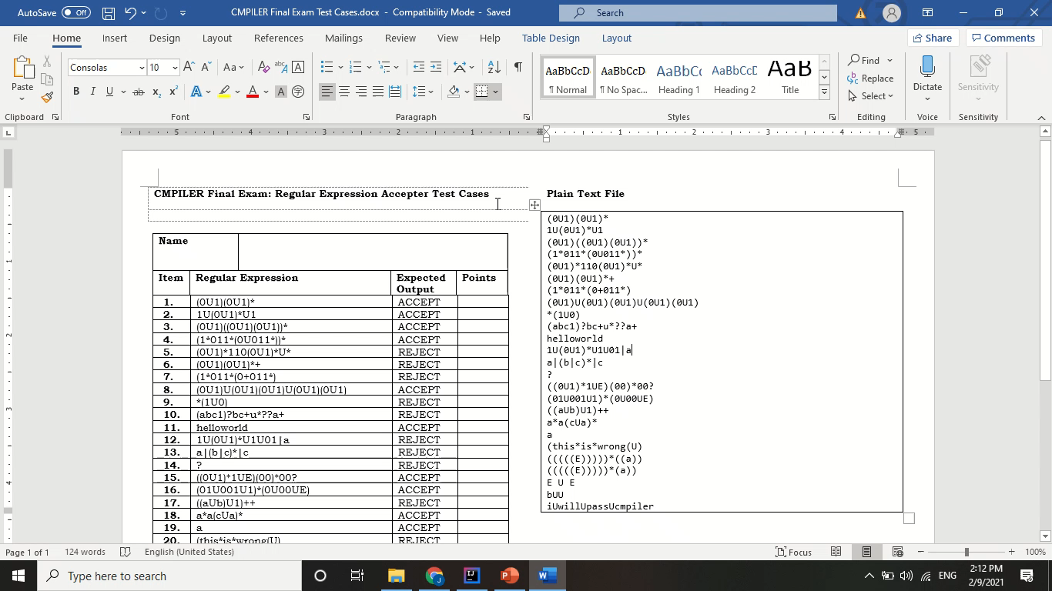
ANG, Jerald Edric D. S12
video presentation

Slide 2
Lexical analysis
The input is read from a text file. For each line, the program feeds this into the LexicalAnalysis class. This class is responsible for tokenizing the input.
In this class, the program converts each symbol (separated by a whitespace delimiter) into a token, which has the TokenType and Lexeme. If it is empty, it will not create a token.
For determining the TokenType, the input is checked using a DFA class. Each end state corresponds to a TokenType. If it is unrecognizable, it is an invalid token.
For this process, the maximal munch algorithm is used.
The tokens will then be saved into a tokenList, which is used as the input for the Syntax analysis part.
Lexical Analysis summary flow:
Input: String lexeme or the original text
Process: check the input per character, match each entry to the DFA and return the last state it is in
Output: Token class, containing TokenType and Lexeme

Slide 3
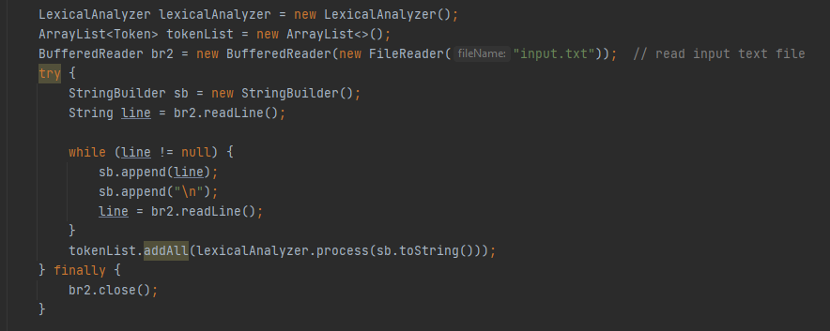
Code snippet
Read text file in Main class

Slide 4
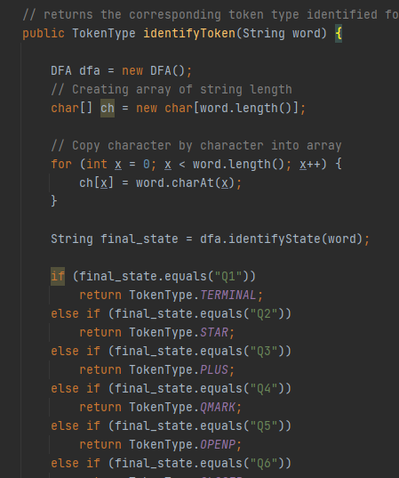
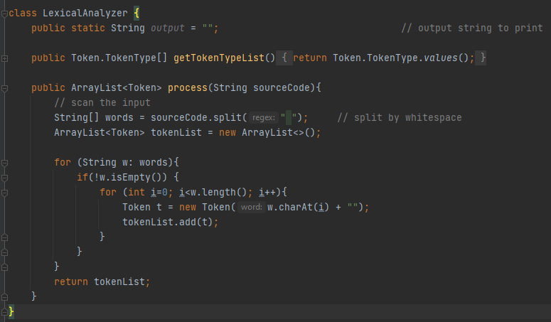
Code snippet
Creating the token; Identifying the tokenType

Slide 5
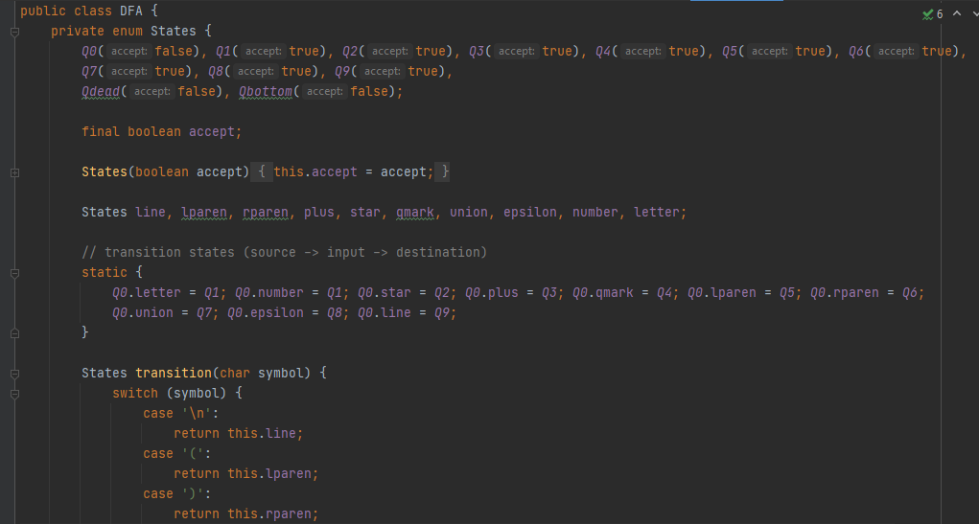
Code snippet
DFA class for checking the input lexeme

Slide 6
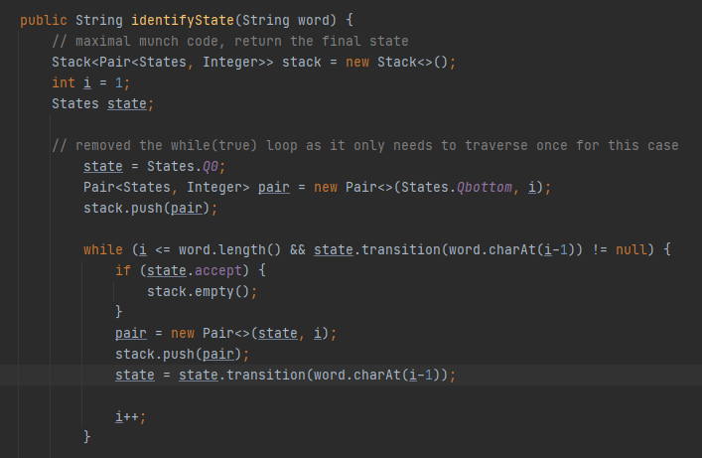
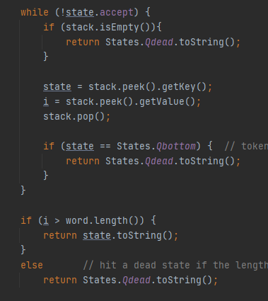
Code snippet
The maximal munch algorithm (modelled from the provided pseudocode in lectures)

Slide 7
Syntax analysis
The grammar is read from a text file. For each production, the program feeds this into the GrammarParser class. This class is responsible for storing the grammar (containing LHS and RHS) in a HashMap.
The LL(1) Table requires the First and Follow sets of the terminals and non-terminals. Thus, the first sets of each is computed, then the follow sets is computed next.
The LL1Table class creates the parsing table. Here, the values are filled by using the first and follow sets. The corresponding production is also matched to its respective terminal column (ex. F → ( E ) | id ; Fill column (, row F with ( E ), and column id, row F with id).
The SyntaxAnalysis class takes the LL(1) table and the stack of input per line. The program will check if the current top of the grammar stack and the current top of the input stack matches. If yes, pop the values. If no, check if this row and column pair has a value in the table. If yes, the program will pop the grammar production and replace it with the cell value. If no, it is invalid.

Slide 8
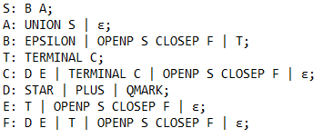
Syntax analysis
The SyntaxAnalysis class also checks if the grammar stack and the input stack is empty. If the grammar stack is not empty, but there are no inputs left, it is an error. If the input stack is not empty, it is also invalid.
If the program detects the input as invalid, it is rejected. If it is valid, it is accepted.
The grammar rules are as follows:
where UNION = “U”, EPSILON = “E”, STAR = “*”, PLUS = “+”, QMARK = “?”, TERMINAL = [a-z],[0-9], OPENP = “(“, CLOSEP = “)”

Slide 9
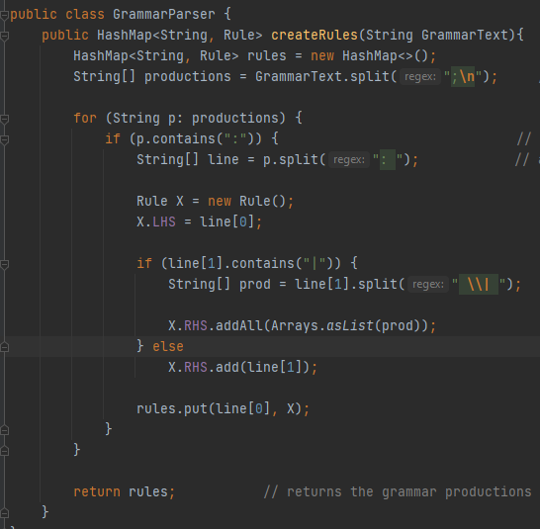
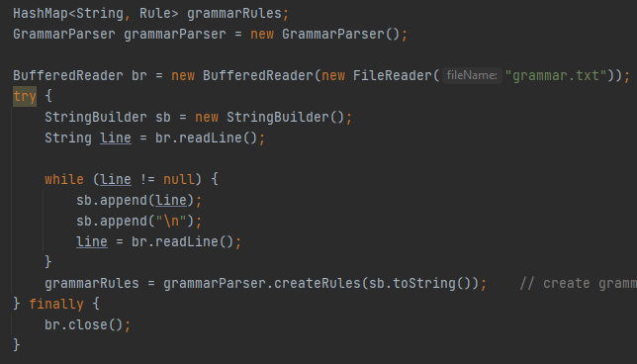
Code snippet
Reading the grammar file in Main class; Storing the grammar

Slide 10
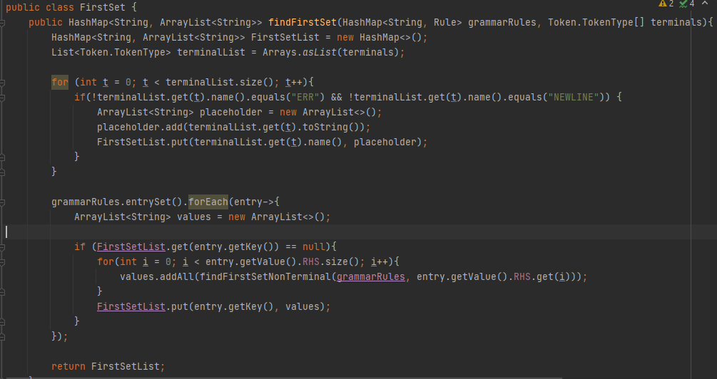
Code snippet
Compute for the First set of the grammar

Slide 11
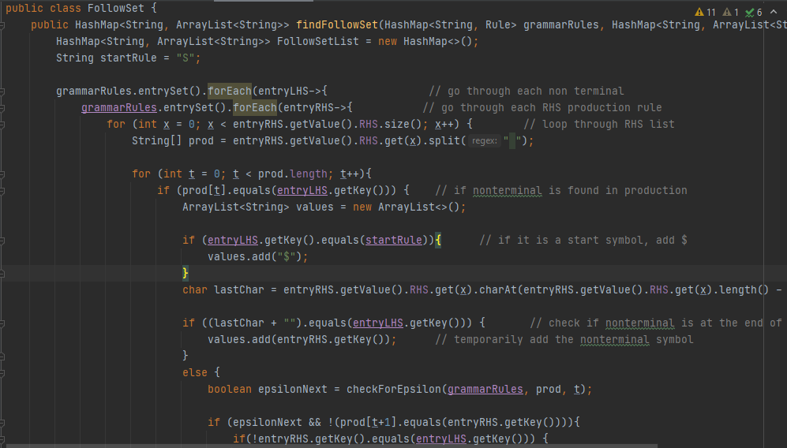
Code snippet
Compute for the Follow set of the grammar

Slide 12
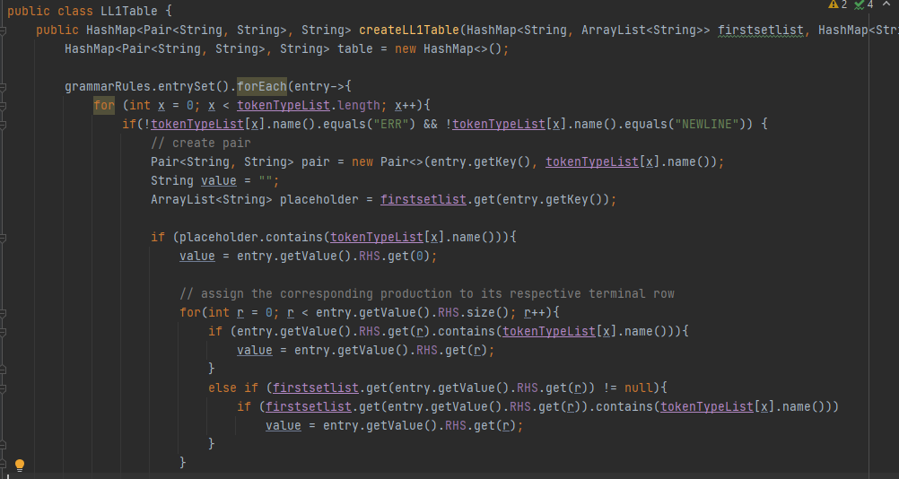
Code snippet
Filling in the LL(1) Parsing table with the first and follow values

Slide 13
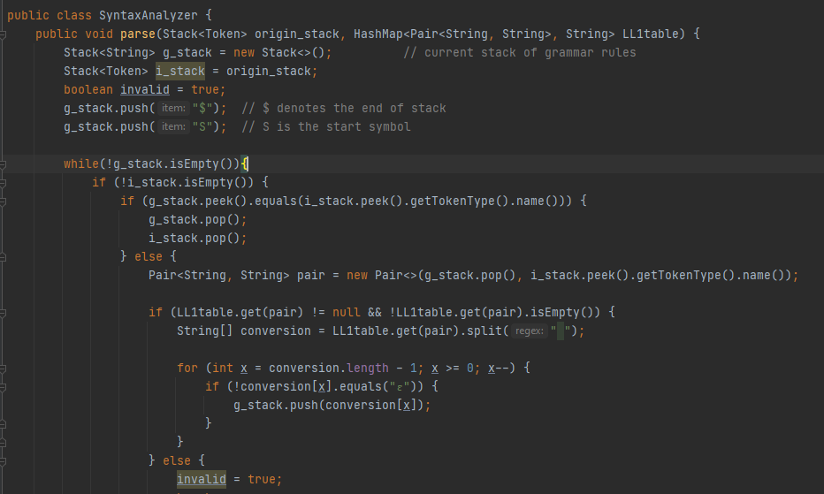
Code snippet
Syntax analyzer utilizing the generated parsing table

Slide 14
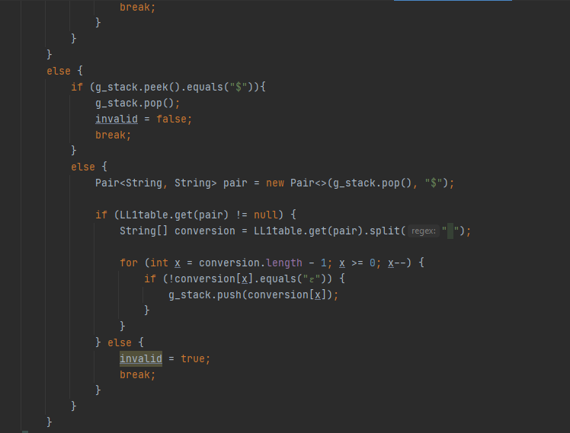
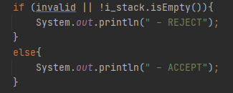
Code snippet
Syntax analyzer utilizing the generated parsing table

